Slide 1

Real Cookie Dough Bars.
Real Ingredients.

Slide 2


Brand Story
Founder
We Challenged the Cookie Dough Status Quo
Todd Goldstein is an entrepreneur and “foodie” who spent the last decade helping entrepreneurs get their start.
In 2011, Todd was diagnosed with a gluten intolerance which jumpstarted his hunt for gluten free products. When his sons were born in 2015 and 2017, they were also diagnosed with a gluten intolerance, increasing his desire to create a gluten free treat that the whole family could enjoy.
Todd and his team recognized that the cookie dough market was a growing trend but still left those with allergies in the raw. Too often, we hear that healthful food tastes bad. So, after 19 iterations and with lots of community feedback, we have developed WHOA DOUGH: a gluten free, vegan, dairy free, soy free, egg free, non-GMO, damn good tasting cookie dough bar perfect for on-the-go snacking.
The Boys
© WHOADOUGH.COM
SALES@WHOADOUGH.COM | (440) 299-7894

Slide 3



The Whoa Dough Way
Whoa Dough is the amazing gluten free, plant based, non-GMO, dairy-free, egg-free, soy-free, allergen-free*, no artificial flavor having, only nine ingredient having, protein delivering, happy-inducing, craving crushing, starting at only 140 calories, health conscious cookie dough bar!
And, YES, they’re VEGAN.
*Only two of our flavors contain nuts
© WHOADOUGH.COM
SALES@WHOADOUGH.COM | (440) 299-7894

Slide 4
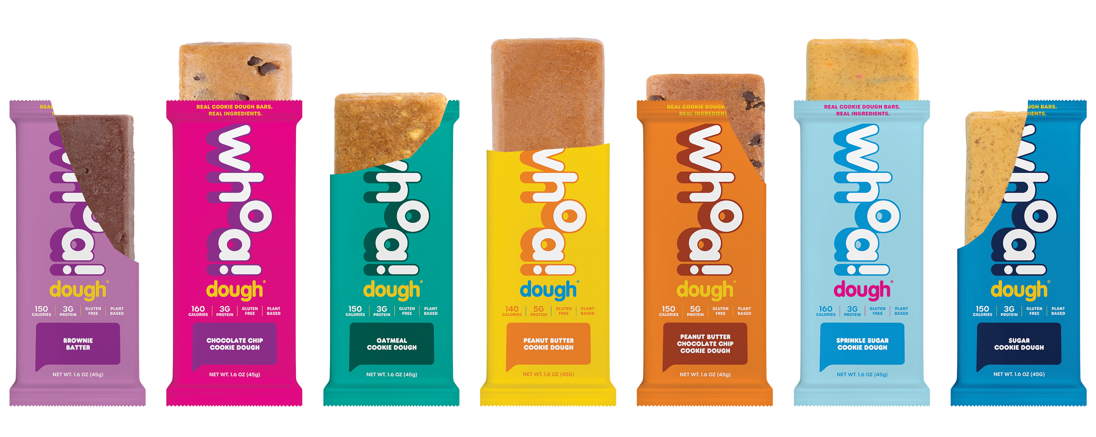
Live healthy, Snack Happy
140-170 calories, 4-5g protein
© WHOADOUGH.COM
SALES@WHOADOUGH.COM | (440) 299-7894

Slide 5
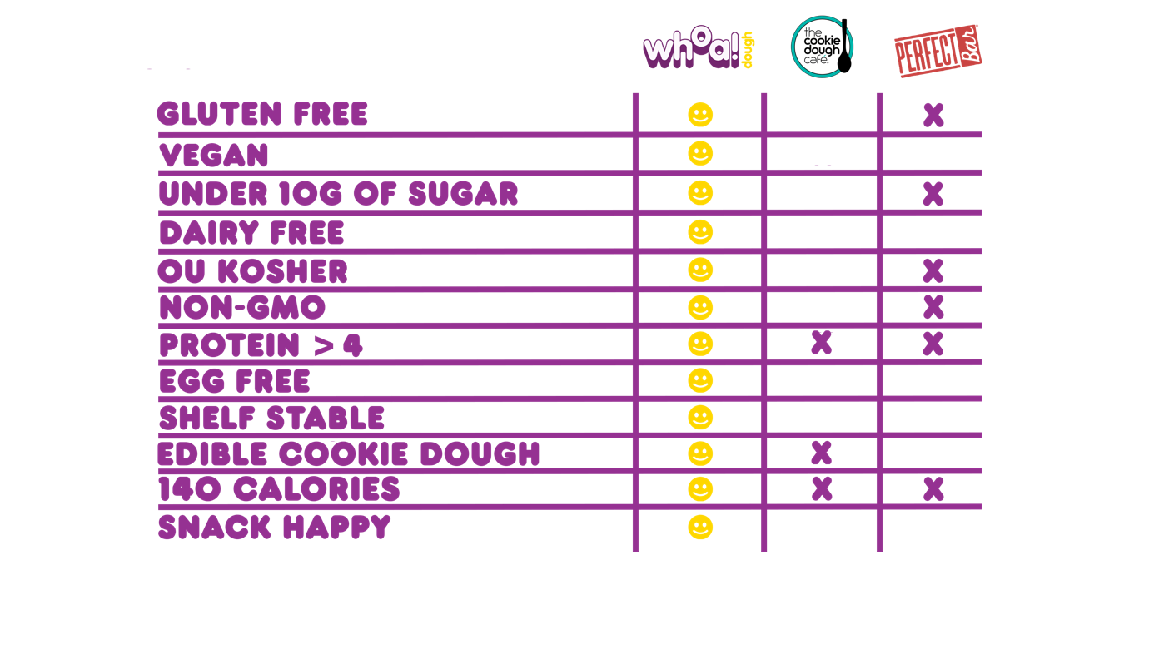


Why Whoa Dough?
How We Compare to Competition
© WHOADOUGH.COM
SALES@WHOADOUGH.COM | (440) 299-7894
Notes:
Call out the Real Cookie. A lot of bars are cookie dough flavored with sugar alcohol. Perfect bar is a meal replacement vs Cookie Dough Café which is full of Allergens

Slide 6
Market Trends
We Stand Out.
The cookie dough market has a year-over-year growth of
9.0%
The plant-based alternatives market is worth over
$3.7 Billion
The U.S. refrigerated snacks segment
generates around
$20 Billion
in annual sales, representing
one-third
of the total snacking market.
Well-being snacks, including nutrition bars,
represent around
$7 Billion
and is growing faster than other refrigerated snacks around
8%
a year over the past three years.
The gluten-free food market in the US is estimated at:
$1.77 Billion
Gluten-free foods accounted for
6.5%
of all food sales in 2015.
Sources: The Good Food Institute, statista.com, futuremarketinsights.com, reportlinker.com, todaysdietitian.com, Univ. of Nev. School of Medicine, marketwatch, Minteldata
© WHOADOUGH.COM
SALES@WHOADOUGH.COM | (440) 299-7894

Slide 7
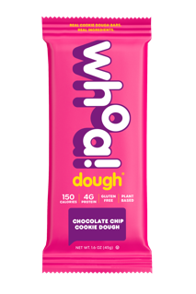
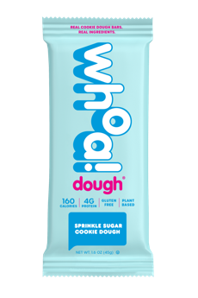
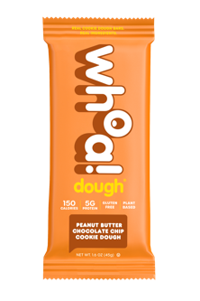

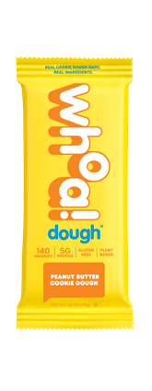
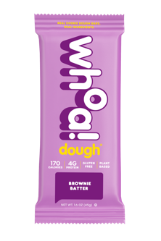
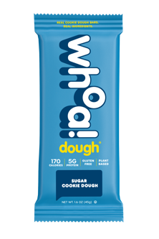
1
2
3
ChocolateChip
Sprinkle Sugar
PB Chocolate Chip
Launch Q4 2020
170%
237%
230%
2022 (Q1) 1663 bars
2021 (Q1) 617 bars
2022 (Q1) 1189 bars
2021 (Q1) 353 bars
2022 (Q1) 1141 bars
2021 (Q1) 346 bars
4
5
6
Brownie Batter
Sugar Cookie
Peanut Butter
274%
249%
254%
2022 (Q1) 1095 bars
2021 (Q1) 293 bars
2022 (Q1) 910 bars
2021 (Q1) 261 bars
2022 (Q1) 754 bars
2021 (Q1) 213 bars
© WHOADOUGH.COM
SALES@WHOADOUGH.COM | (440) 299-7894
Notes:
6

Slide 8


Report on February 15, 2022
Top 27%
of all bars sold in bar category (#105/390)
Total growth over last
12 weeks = 552%
Total growth over last
24 weeks = 710%
© WHOADOUGH.COM
SALES@WHOADOUGH.COM | (440) 299-7894

Slide 9

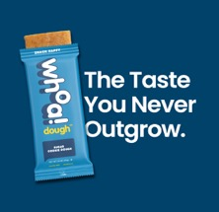
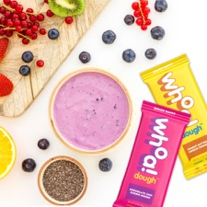
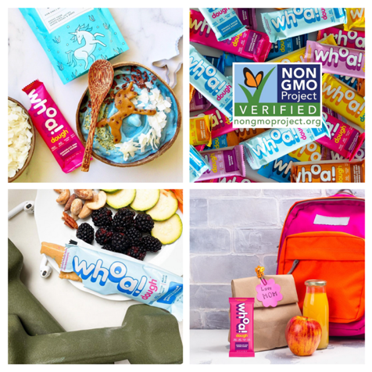


Sales info
Case Pack: 10 bars per Sleeve
Retail Price: $2.49 per bar
SKU Rank:
  Chocolate Chip
  Brownie Batter
  Oatmeal
  Sprinkle Sugar
  Peanut Butter Chocolate Chip
  Sugar Cookie
  Peanut Butter
© WHOADOUGH.COM
SALES@WHOADOUGH.COM | (440) 299-7894

Slide 10
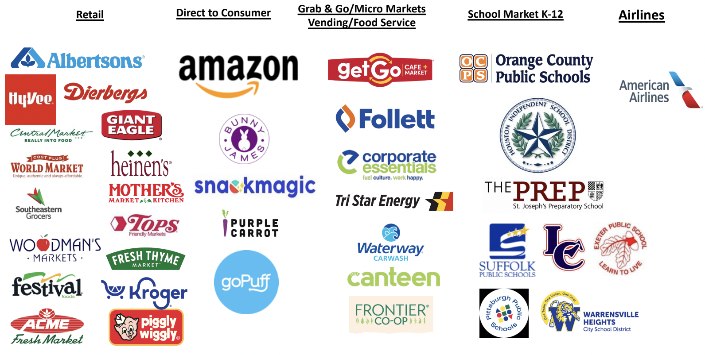
Where to Buy Whoa Dough
Sold in over 2,500 retailers nationwide including these below!
© WHOADOUGH.COM
SALES@WHOADOUGH.COM | (440) 299-7894

Slide 11
Our Distributors
Gordon Food Service (Plant City, FL)
KeHE – All locations
Labatt – One location in the Southwest
Lipari - All locations
UNFI – 3 West Coast DCs: Denver (CO), Rocklin (CA), Ridgefield (WA)
Vistar – All 21 locations starting in the fall
DPI – Rocky Mountain (CO) & West (CA)
© WHOADOUGH.COM
SALES@WHOADOUGH.COM | (440) 299-7894

Slide 12
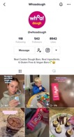
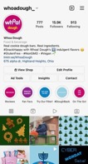
Driving Brand
Awareness &
Customer Engagement
Digital Marketing Tactics
Followers | 22K | 7.4K | 1K | 1.1K
Reach | 1.4M | 2.1M | 5.5K | 75K
Engagements | 21K | 1.8K | 272 | 6K
Views | 3.4K | 92K | 1K | 61.4K
  Awareness
    Geo-Targeted Media
    Paid & Organic Social Media
    In store Demos
  Engagement
    Push notifications leveraging mobile location data to reach consumers in the store
  Conversion
    Incentive based campaigns offered exclusively at retailer such as coupons and promotions.
© WHOADOUGH.COM
SALES@WHOADOUGH.COM | (440) 299-7894

Slide 13
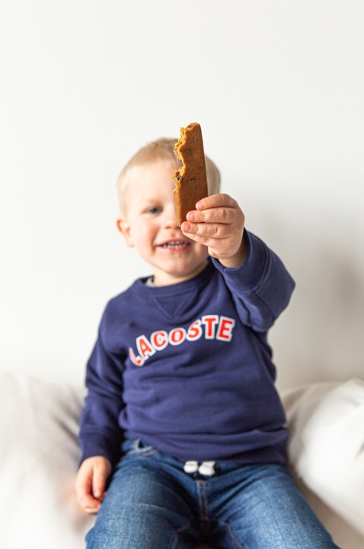
Thank You!
For more information,
please contact Todd Goldstein:
Sales@whoadough.com
440-299-7894
@whoadough_
@whoadough
@whoadough
@whoadough

